Slide 1

Unpacking the Army Corps Peninsula Seawall Report
September 21, 2021
Cashion Drolet, HCF Chief Advocacy Officer
Wesley Wilson, USACE Project Manager
Meredith Moreno, USACE Lead Archaeologist
Dale Morris, City of Charleston Chief Resilience Officer

Slide 2
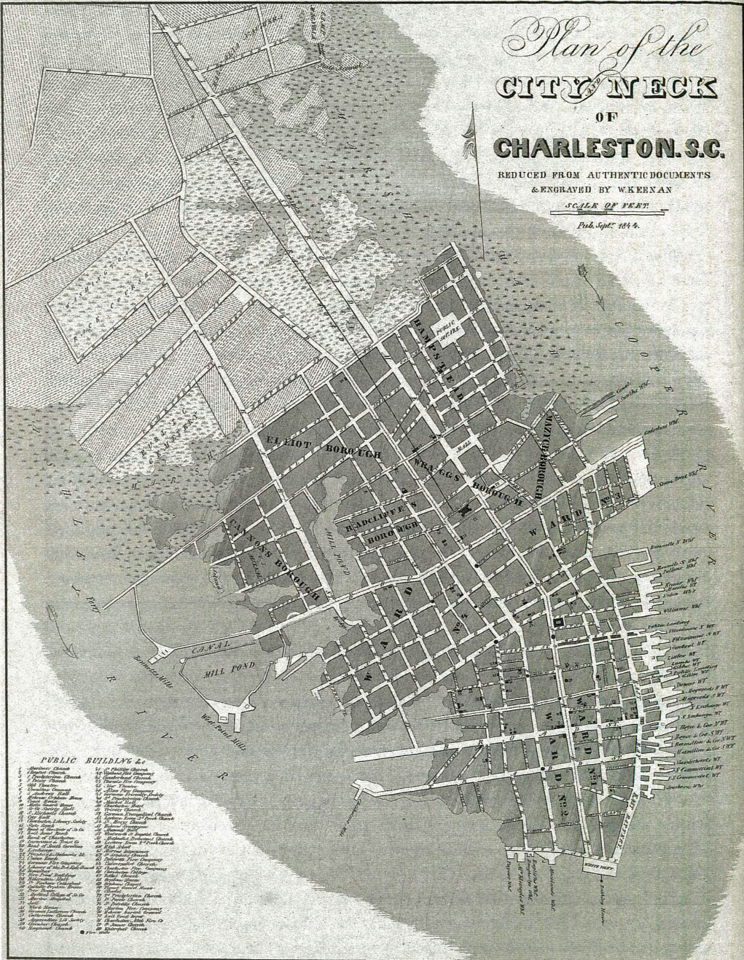
Plan of the City & Neck of Charleston, 1844

Slide 3
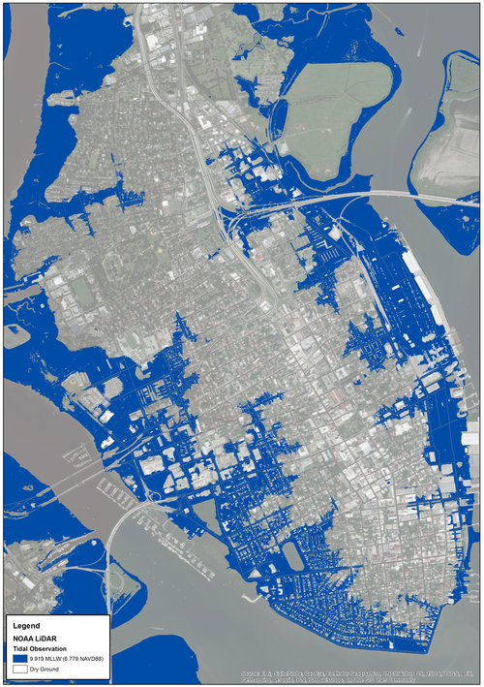
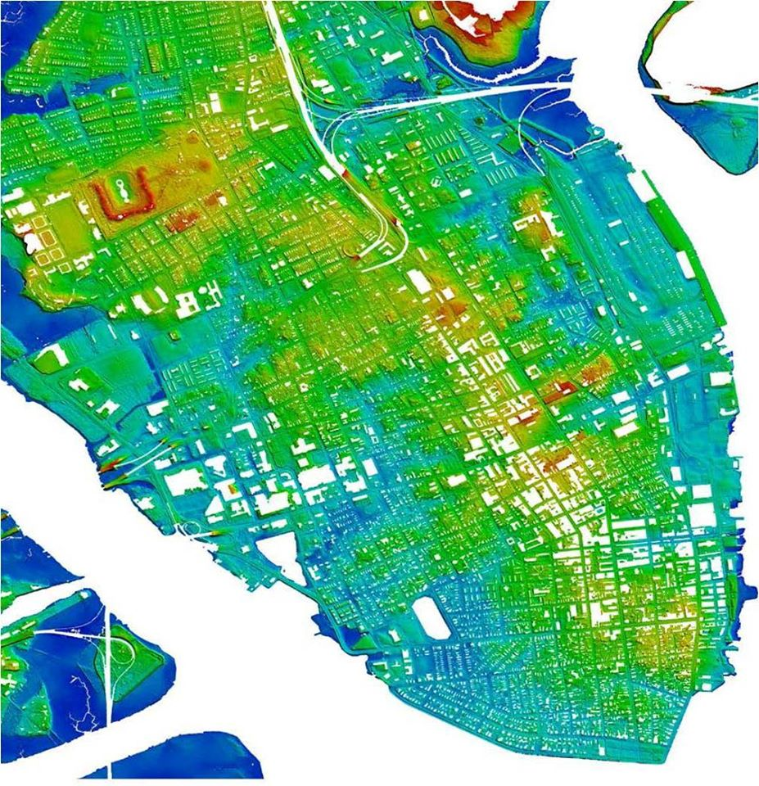
TOPOGRAPHY & FLOODING

Slide 4
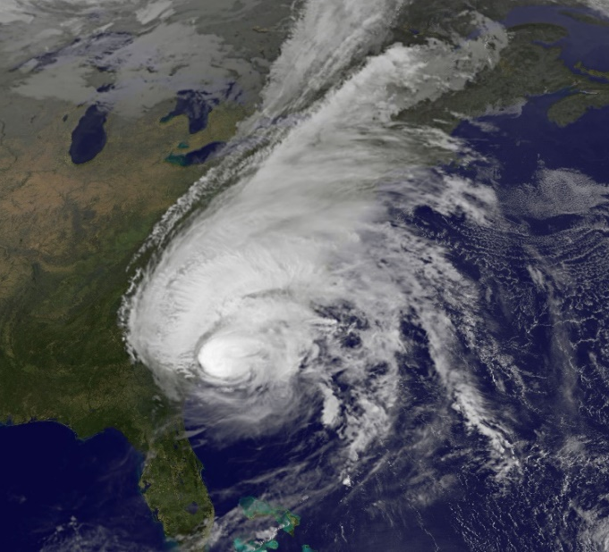
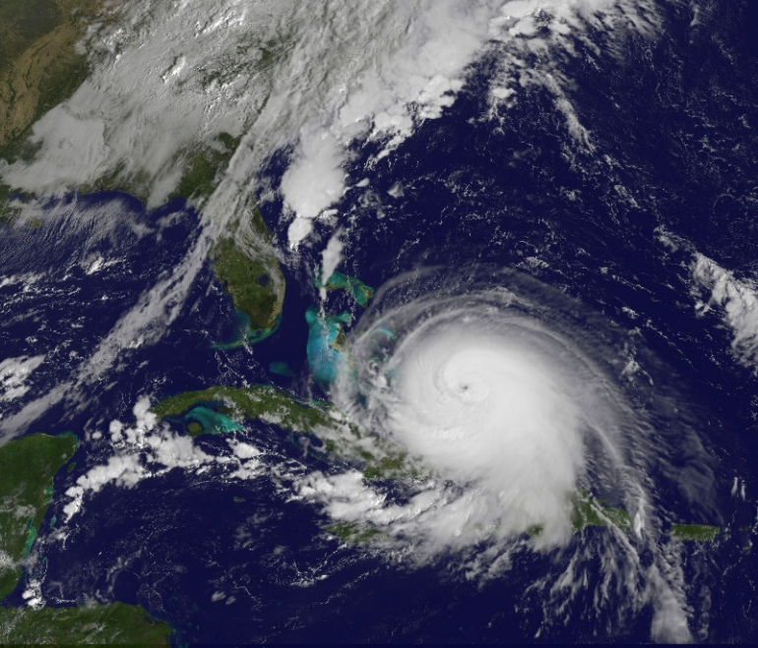
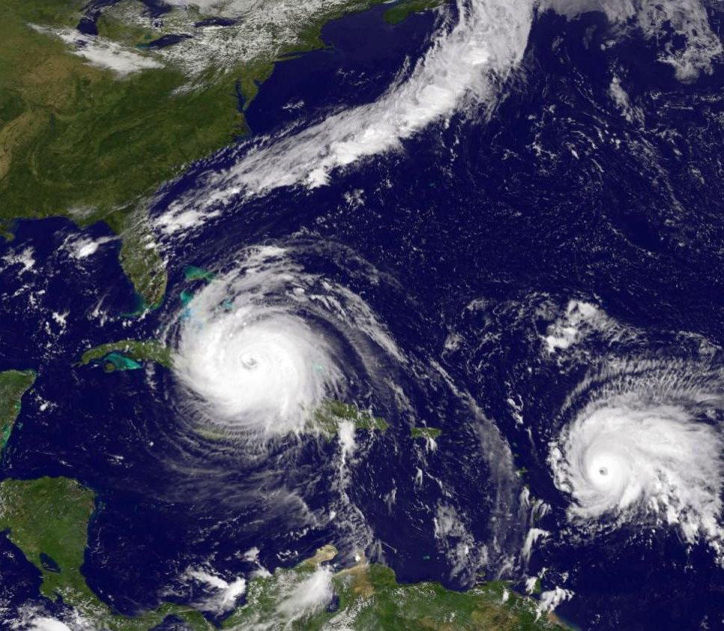
THREE MAJOR STORMS IN THREE YEARS
Joaquin: 2015
Matthew: 2016
Irma: 2017

Slide 5
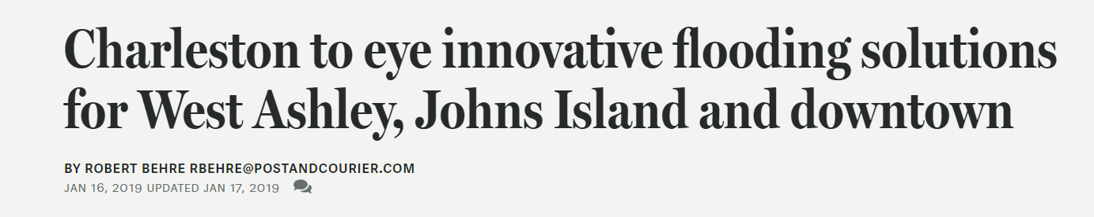
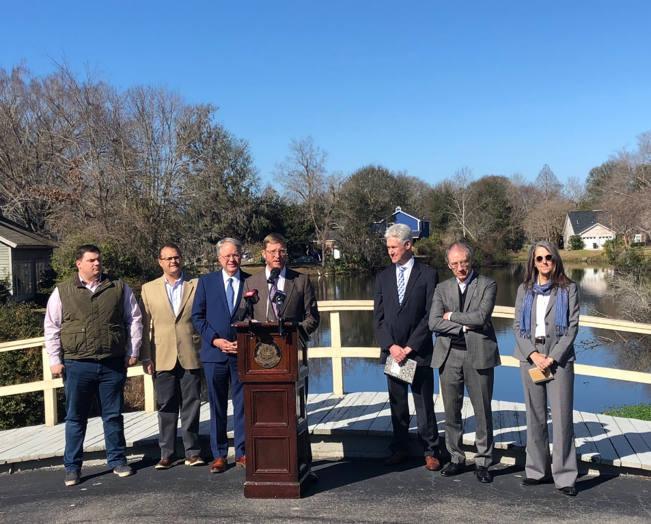

DUTCH DIALOGUES CHARLESTON

Slide 6


Slide 7
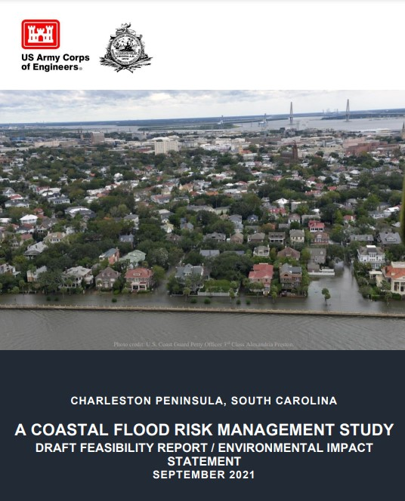
Access online and submit feedback @: https://www.sac.usace.army.mil/Missions/Civil-Works/Supplemental-Funding/Charleston-Peninsula-Study/
Released on September 10, 2021
45-day review period
Deadline for public comments: October 25th

Slide 8
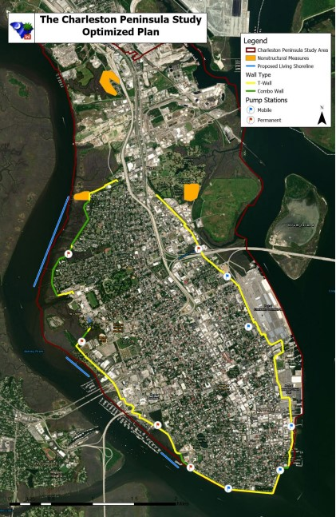
Long-range infrastructure project looking out to 2082
293-page document filled with technical jargon
Focus on:
  Executive Summary
  Chapter 2.2 – Problem Statements
  Chapter 8.1-8.4 – Tentatively Selected Plan
  Interactive Study Overview (website)
  Appendix A – Visual/Aesthetics
  Appendix G – Dutch Dialogues
Impacts to Historic and Cultural Resources – Programmatic Agreement (Appendix D)
Citizen Advisory Committee

Slide 9

Charleston Peninsula coastal flood risk management Study
Historic Charleston Update
USACE Charleston District
September 21, 2021
Celebrating 150 Years of Serving South Carolina and the Nation
www.sac.usace.army.mil/150

Slide 10
Agenda
Programmatic Agreement/Section 106
Problem
Optimized Plan
Without A Project
Timeline
Public Comments

Slide 11
Programmatic Agreement/Section 106
What is a programmatic agreement? “Defers final identification and evaluation of historic properties to pre-construction, engineering and design phase.”
    Refining APE
    Preliminary viewshed analysis
    Initial effects determinations
    Mitigation
    Detail on archaeological and historic structure surveys needed
    Design reviews
    Review timeframes
    Review process

Slide 12
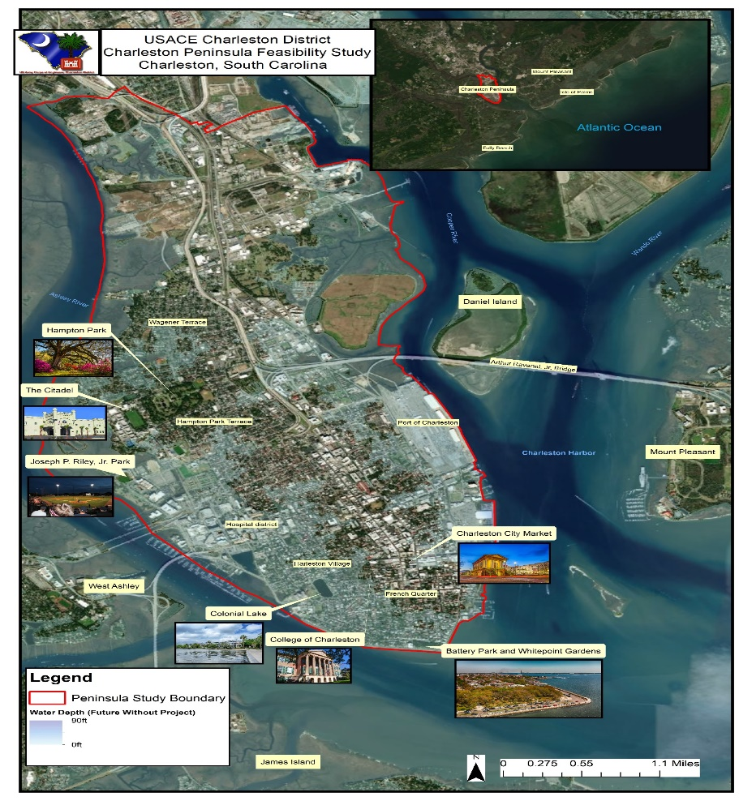
The problem
Significant vulnerability to storm surge inundation
Storm surge inundation impacts:
    Public health including life loss
    Access to critical facilities, emergency services, and evacuation routes
    Economic sustainability of the City including businesses, organizations, and residents

Slide 13
The optimized plan
Cost - $1.1B
Benefit Cost Ratio – 10.2:1
Added Living Shorelines
Reduced Impacts to Wetlands
Added Aesthetic Mitigation
Refined Pump Sizes/Locations
Modeled Impacts to Communities
Why Non-Structural?

Slide 14
Study Cost Drivers
Federal Cost Share ($715M) and Non-Federal Cost Share ($385M)
Reduced Fish & Wildlife Costs
Reduced Construction Costs
Reduced Pump Costs
Eliminated Wave Attenuator (Breakwater) Costs
Refined Non-Structural Costs
Increased Cultural Mitigation Costs
Added Aesthetic Mitigation Costs

Slide 15
Impacts to surrounding communities
Coastal modeling analyzed areas in James Island, West Ashley, North Charleston, Daniel Island and Mount Pleasant.
Determined marginal difference in water surface elevation around 1inch in a small number of areas.
Structural damages highly unlikely and construction of a wall would have negligible adverse effect of increased flooding during surge event.

Slide 16
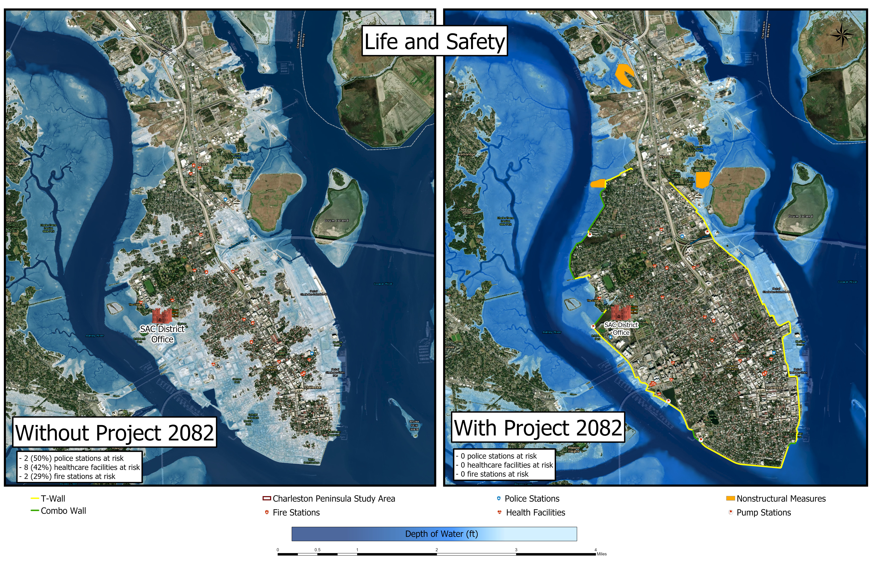
LIFE/SAFETY Without Project

Slide 17
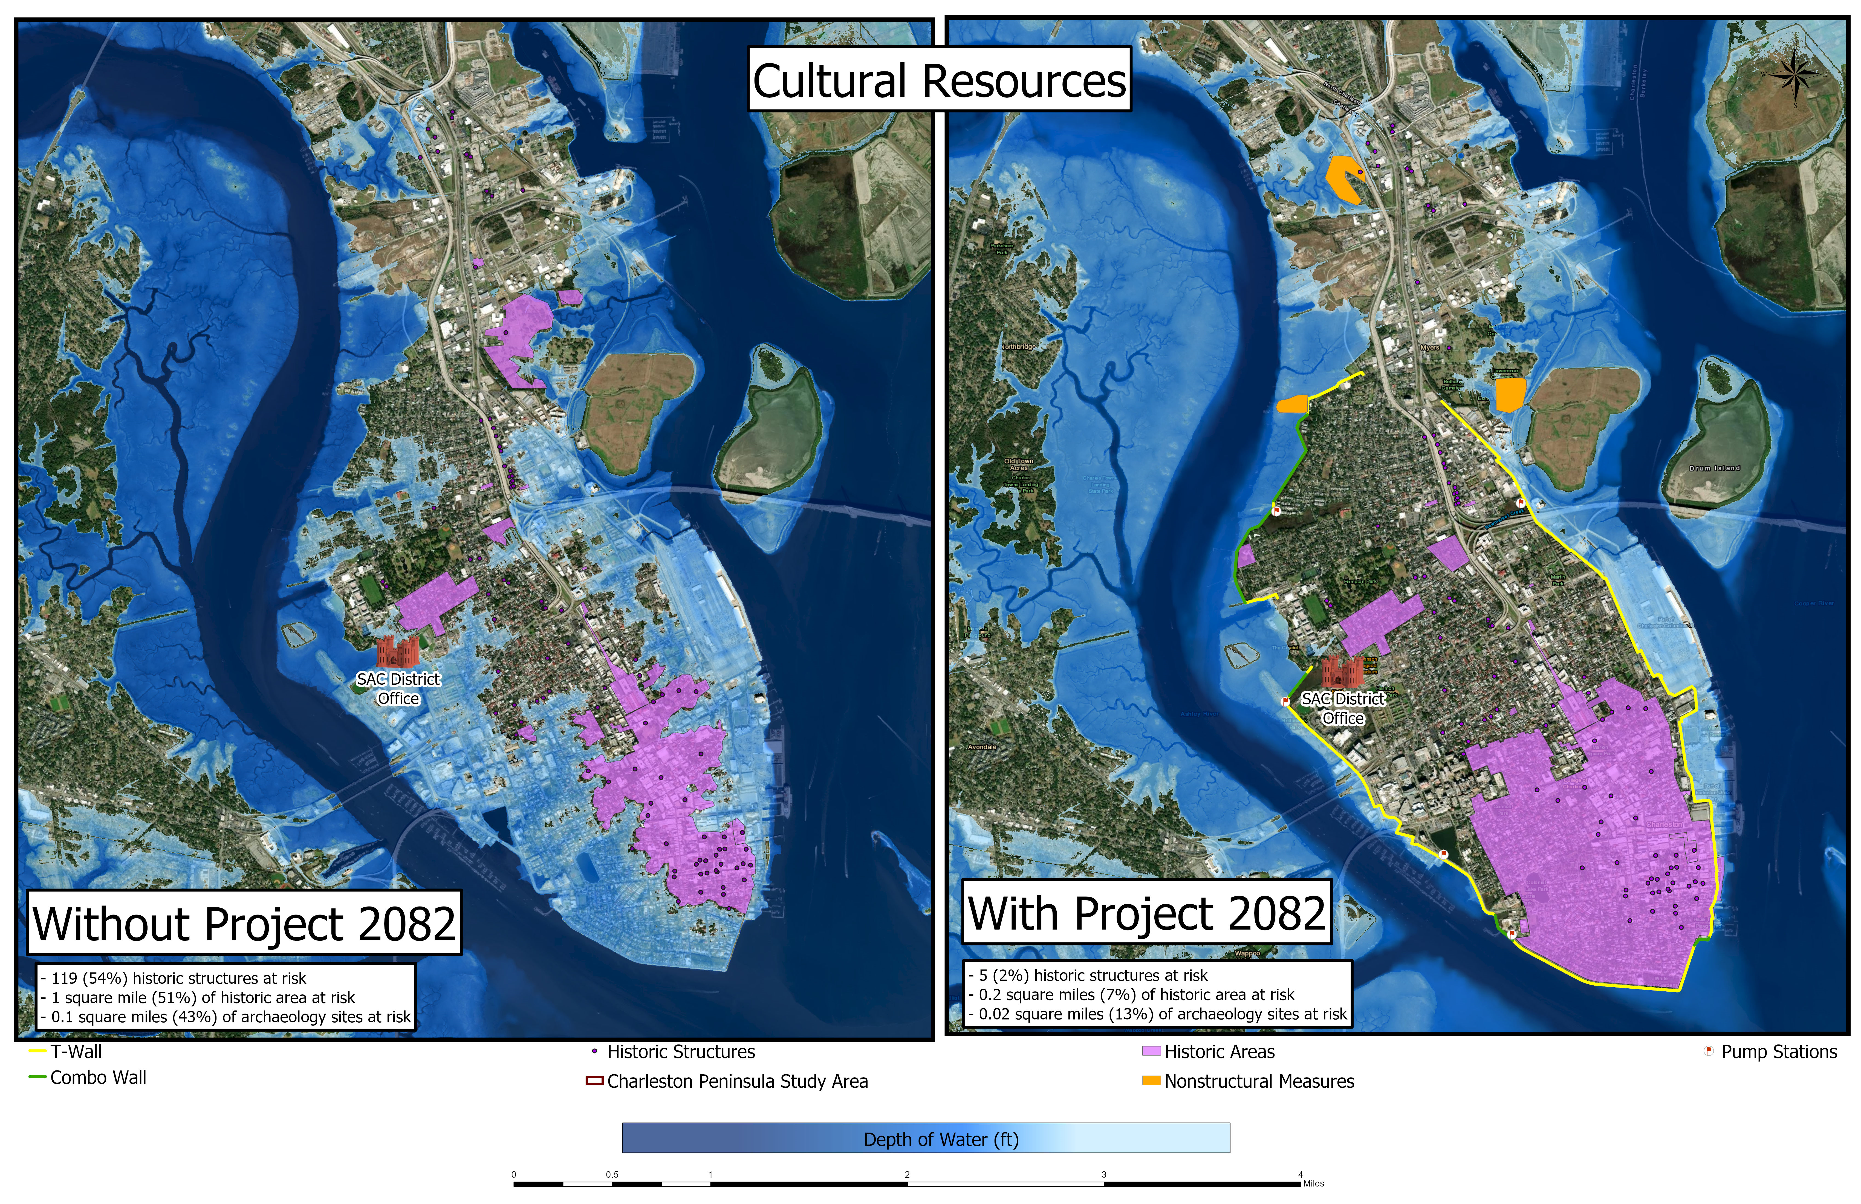
Historical impacts Without Project

Slide 18
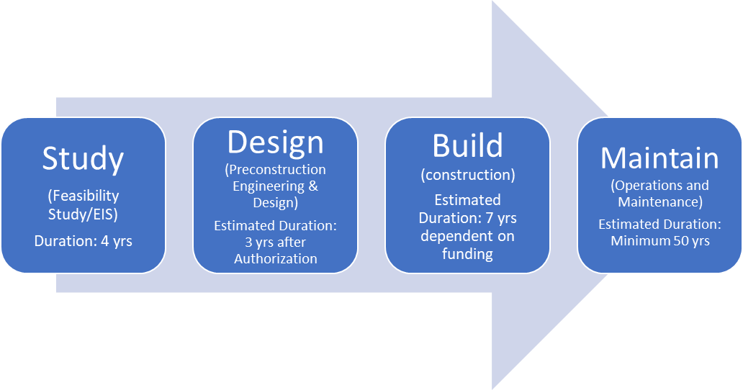
timeline
We are here
Study effort initiated
(2018)
Recommendation by Chief of Engineers for Authorization
City of Charleston Maintains Project

Slide 19
TIMELINE
September 10 – Draft Feasibility Report/EIS Released to Public (45 days required)
September 14 – Charleston City Council Update
October 5 – USACE Public Meeting (Virtual)
October 25 – Review Period Ends
November 15 – USACE Agency Decision Milestone (tentative plan to recommended plan)
December – City Signed Letter of Support for Recommended Plan
December – City Signed Financial Self Certification
December – City Signed MOU to Assess Visual Impacts in PED Phase
December – City Signed Programmatic Agreement
January – February 2022 – USACE Final Report Quality & Technical Reviews
March 2022 – USACE Submits Final Report to South Atlantic Division
June 2022 – State/Agency Review
August 2022 – Signed Chiefs Report

Slide 20
Peninsula study website & FAQ
Visit our website for latest information: https://www.sac.usace.army.mil/Missions/Civil-Works/Supplemental-Funding/Charleston-Peninsula-Study/
Study website updated with Draft Feasibility Report/EIS, latest Frequently Asked Questions, EIS Scoping Meeting Video and Future Study Videos (ex. Charleston City Council, Virtual Public Meetings, Etc.)

Slide 21

How to comment
Email Comments: chs-peninsula-study@usace.army.mil
Written Comments:
    Charleston District, Planning and Environmental Branch
    69A Hagood Ave
    Charleston SC, 29403
Website Electronic Comment Form:
End of Comment Period – October 25, 2021

Slide 22
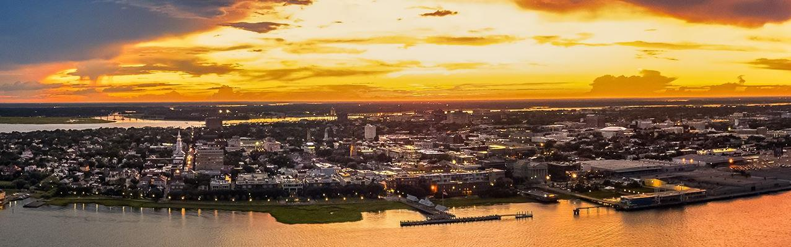
THANK YOU!
Charleston-sc.gov

Slide 23
Unpacking the Army Corps Peninsula Seawall Report
Q & A
Type your questions into the questions box on your screen.

